Slide 1
Data Structures and Algorithms (14)

Slide 2


Divide and conquer

Slide 3

Principle

Slide 4
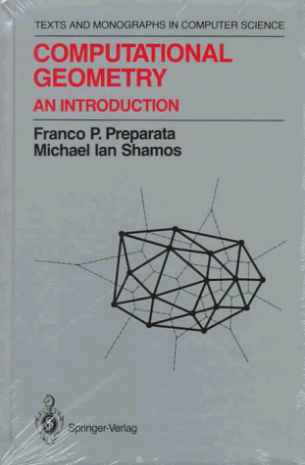
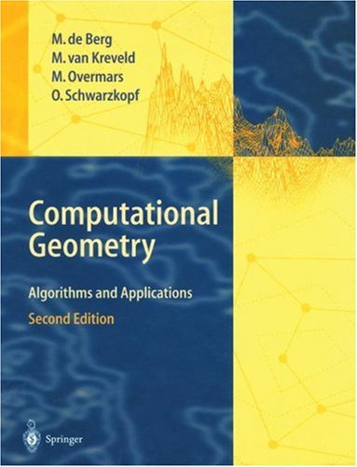
Geometry
Full of algorithmic topics
  just like graphs and strings

Slide 5

Nearest points

Slide 6
The problem
Input:
  n points in the plane
    Each point is specified by their coordinates.
Output:
  Output two closest points

Slide 7
Naïve algorithm
O(n²) time
  There are O(n²) distances.

Slide 8
A clever algorithm
Initialization:
  Sorting the n points according to their x coordinates in O(n log n) time
Strategy
  Divide-and-conquer recursive algorithm

Slide 9
Strategy
Partition the points in two sets L and R with the same size such that all points L are to the left of all points in R.
Output a closest pair among the following three:
  (1) Recursively find a closest pair in L.
  (2) Recursively find a closest pair in R.
  (3) Find a closest pair of points (p, q) such that p belongs to L and q belongs to R.

Slide 10
A key observation
Step (3) can be done cleverly from the results of Steps (1) and (2):
  For each node in L, we just need to check at most 8 points in R.

Slide 11
Specifically,
Suppose that d is the smallest distance obtained from Steps (1) and (2).
  Any two points in R are at least d units apart.
Therefore,
  Any d-by-d box in R has at most 4 points.

Slide 12
Illustration
L
R
At most 4 points
d
d
d
d
At most 4 points
d
d

Slide 13
Details
We have to pre-sort all the nodes according to their y coordinates at the beginning of the algorithm.
Implementing Step (3) in linear time.
  Keep in a sorted list Y all points of R whose x-coordinates are at most d-units away from the partition line between L and R.
  For each point p in L,
    check four points of Y above p.
    Check four points of Y below p.

Slide 14
R1
R2
L1
R3
L2
R4
L3
R6
R5
L4
R7
R8

Slide 15
Recurrence relation
T(n) = 2 T(n/2) + O(n).
According to the master theorem, we have T(n) = O(n log n).

